Slide 1
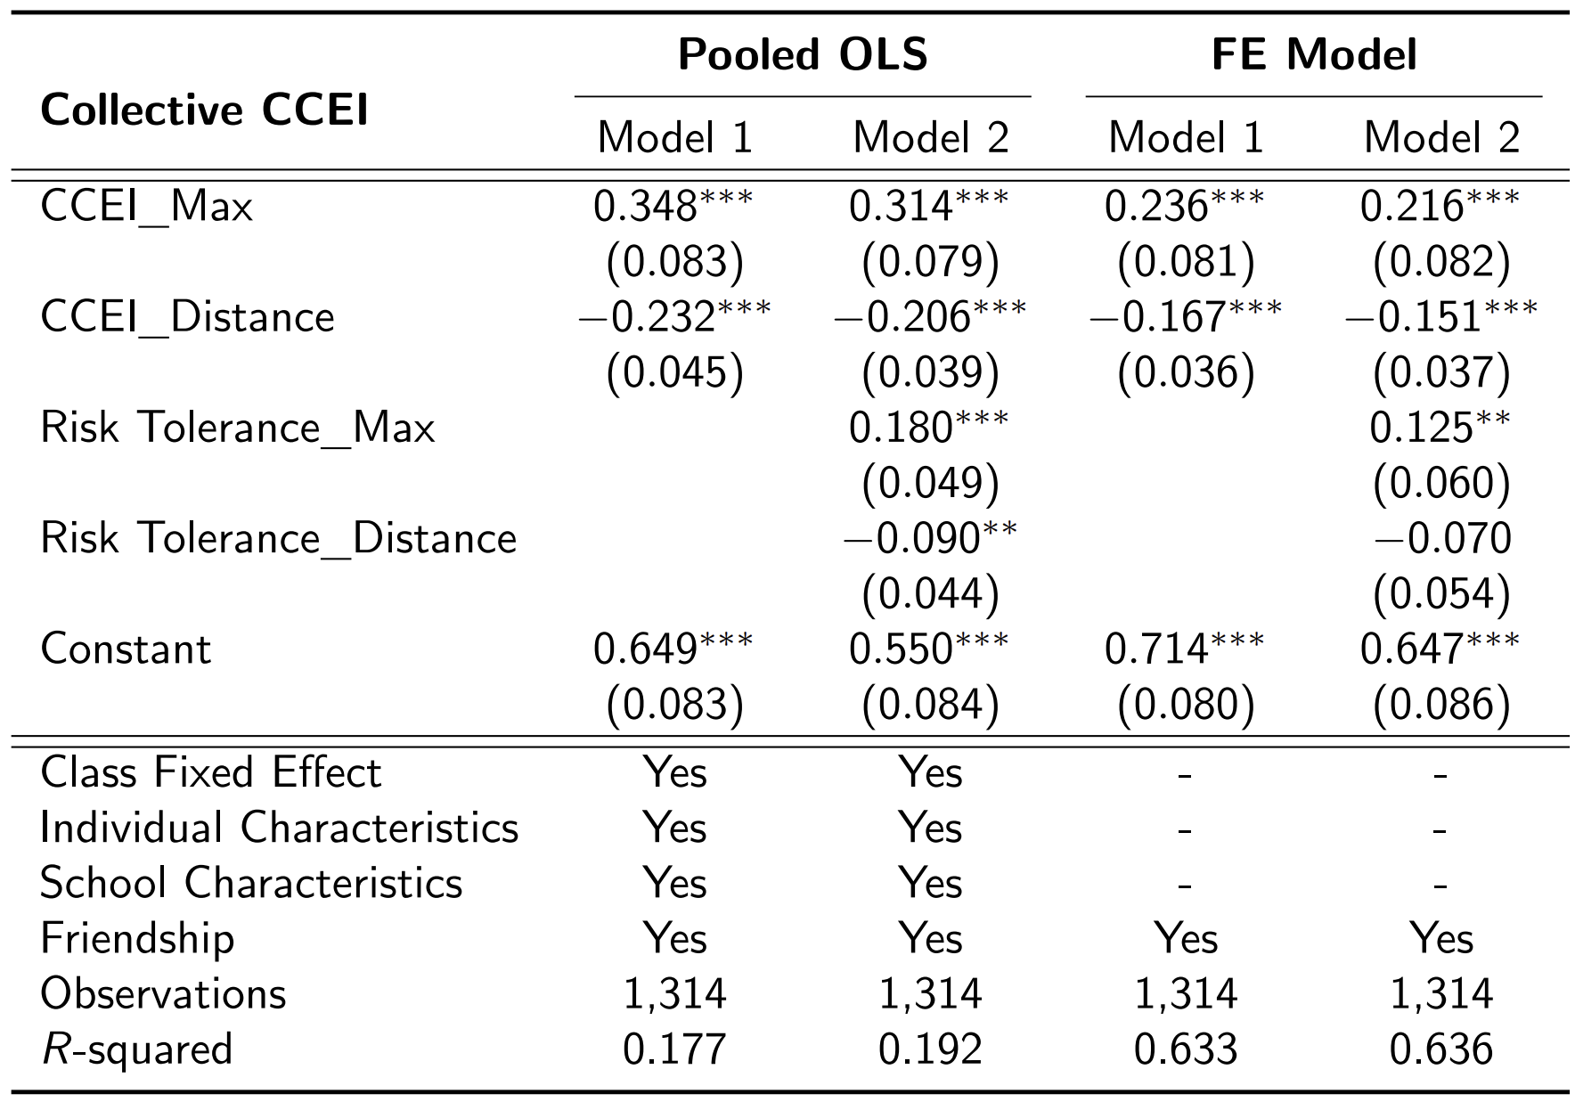
Rationality Extension
Collective CCEI increases in CCEI of a more rational individual and decreases in the difference between CCEIs of two individuals, even after controlling for preferences.

Slide 2
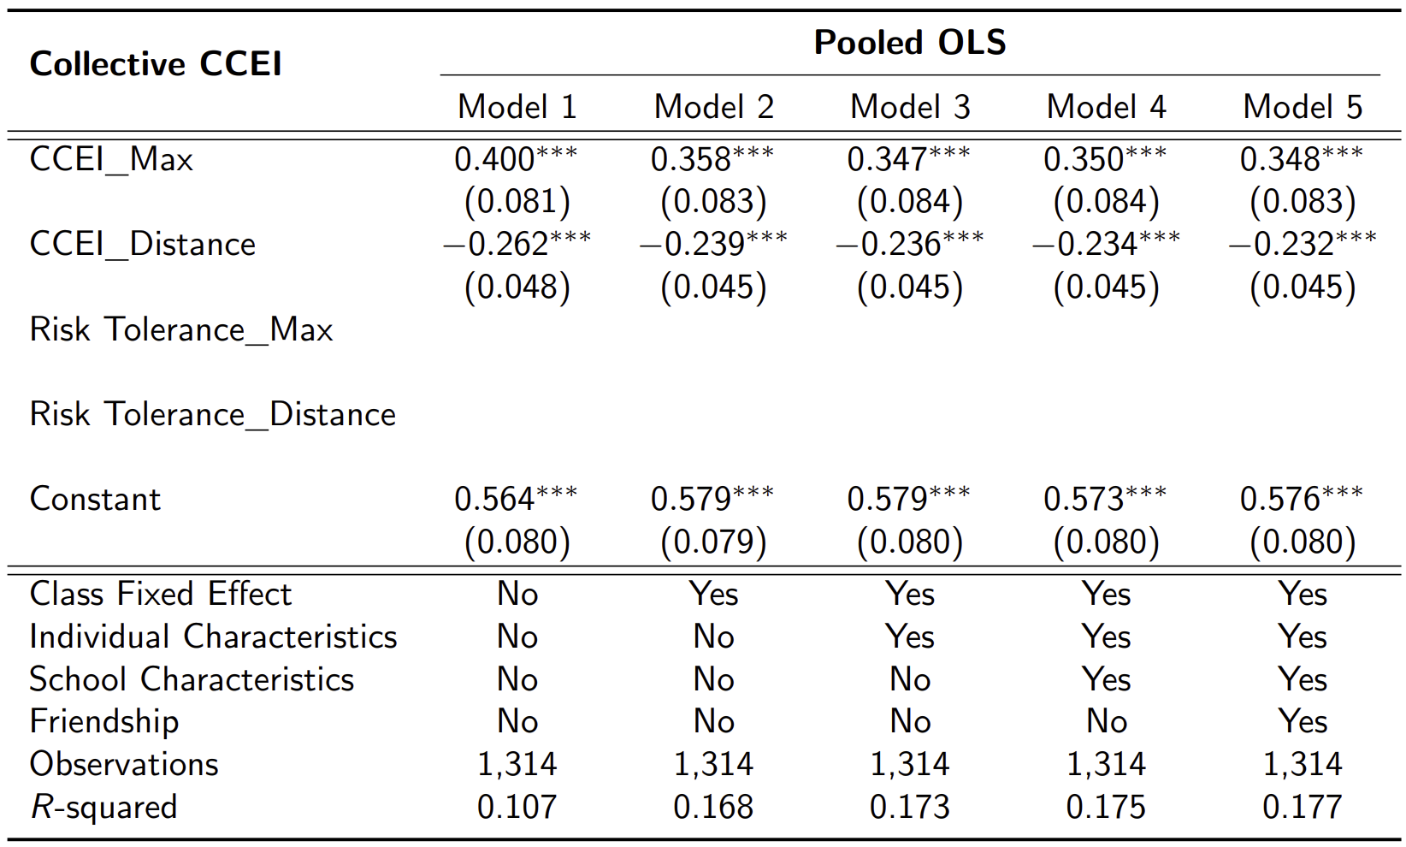
(수정) Rationality Extension

Slide 3
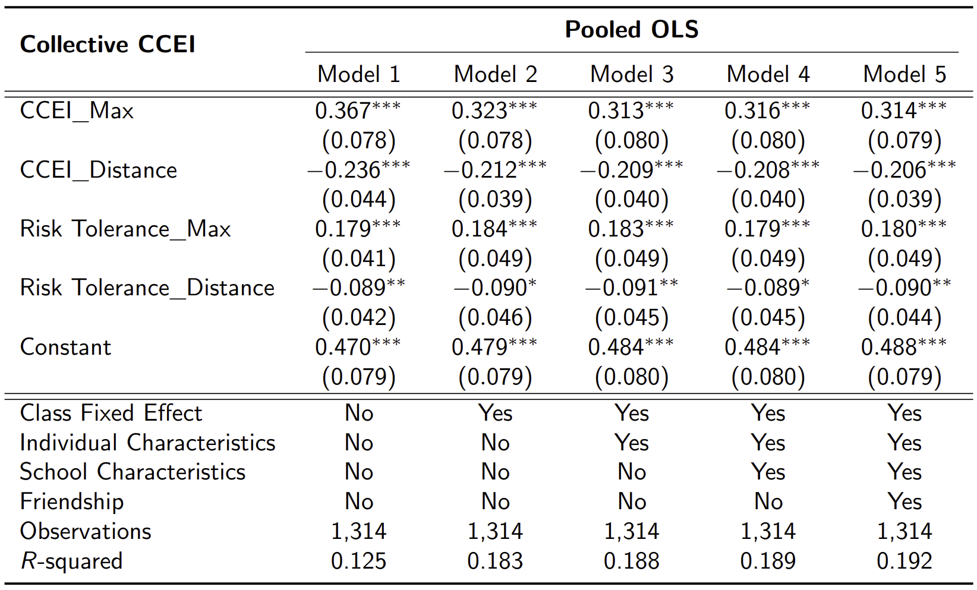
(수정) Rationality Extension

Slide 4
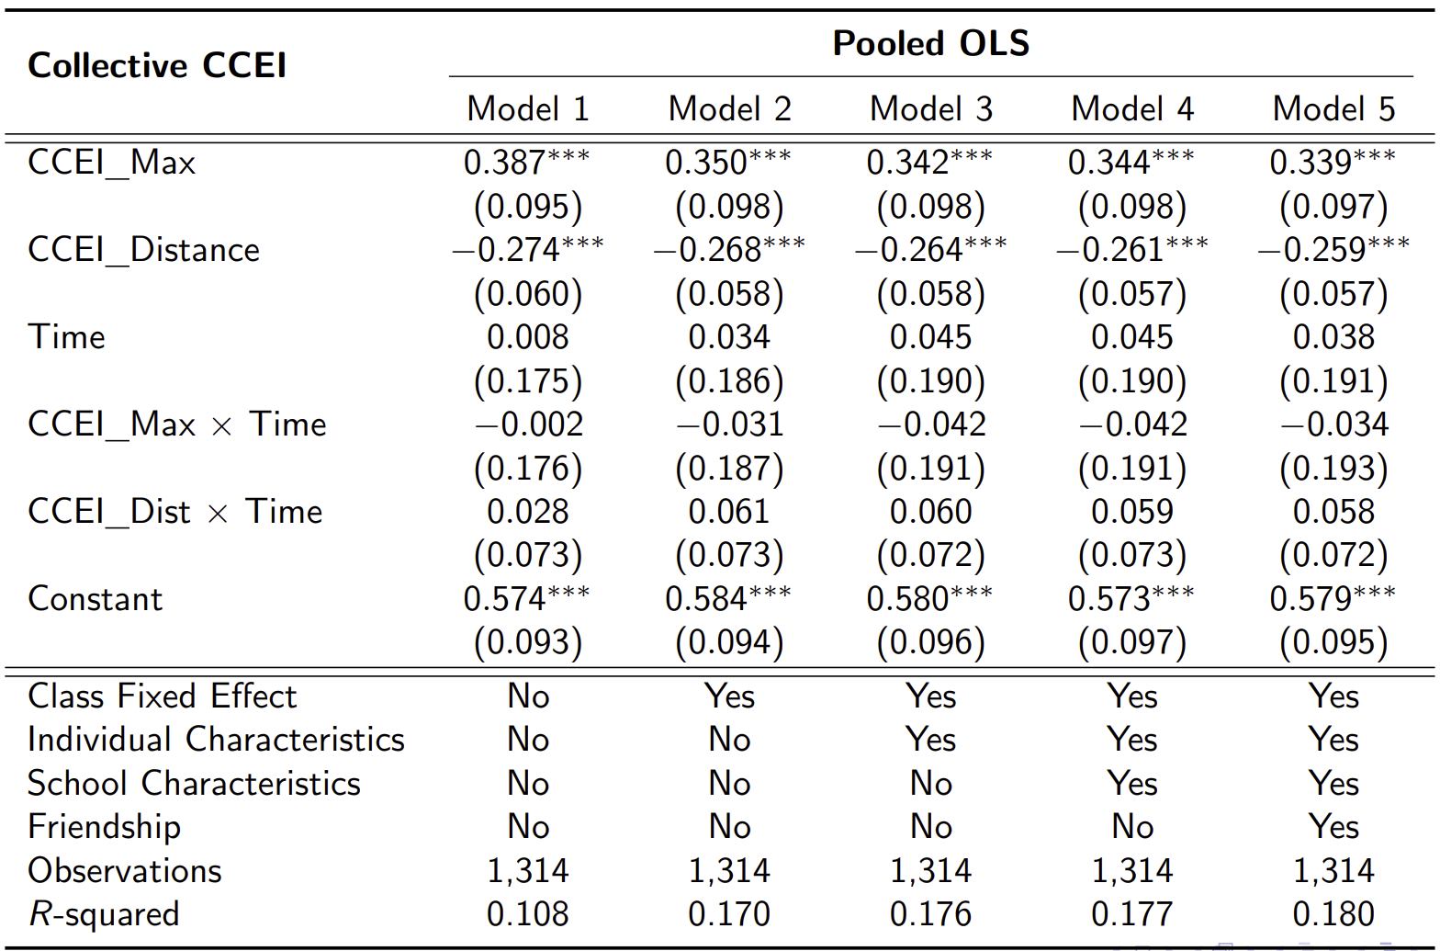
(수정) Rationality Extension

Slide 5
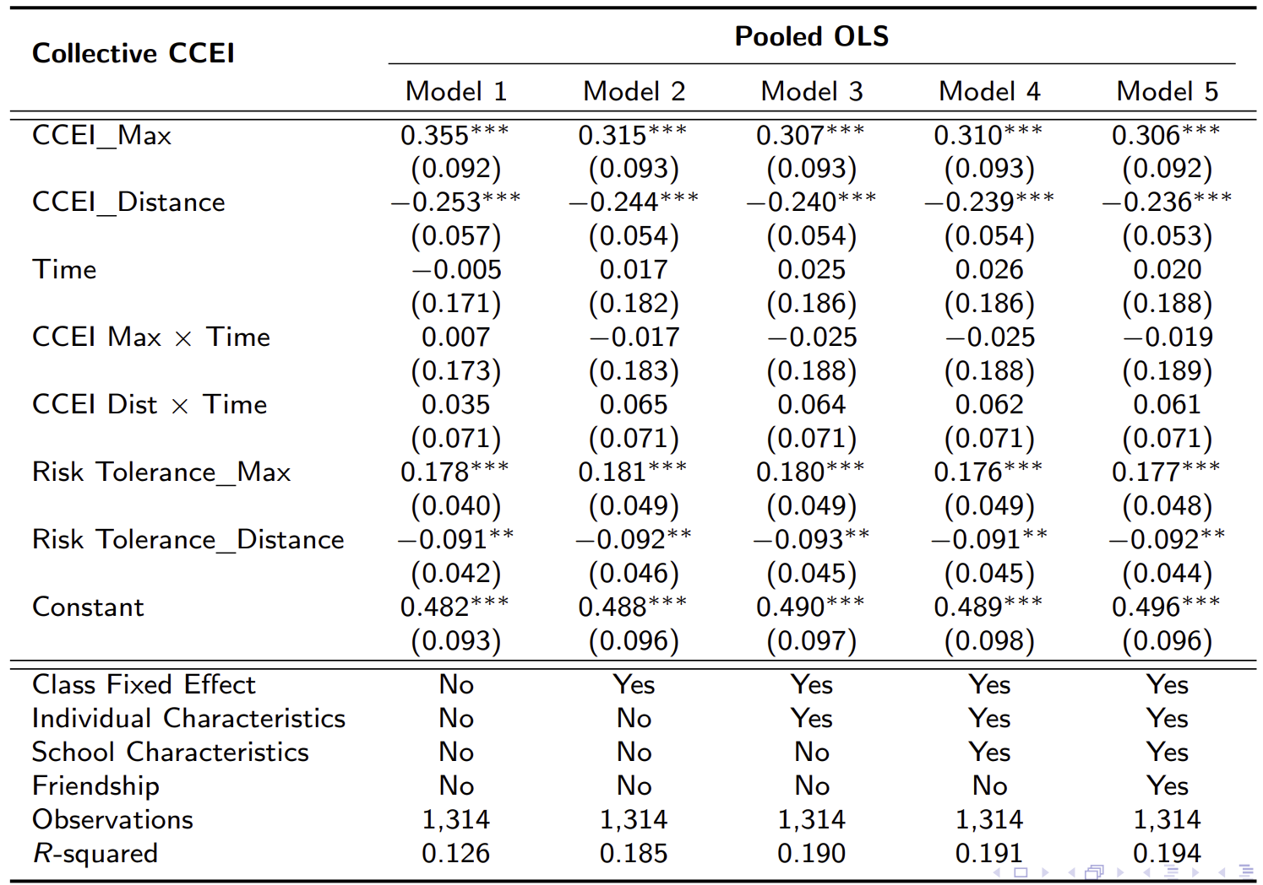
(수정) Rationality Extension

Slide 6
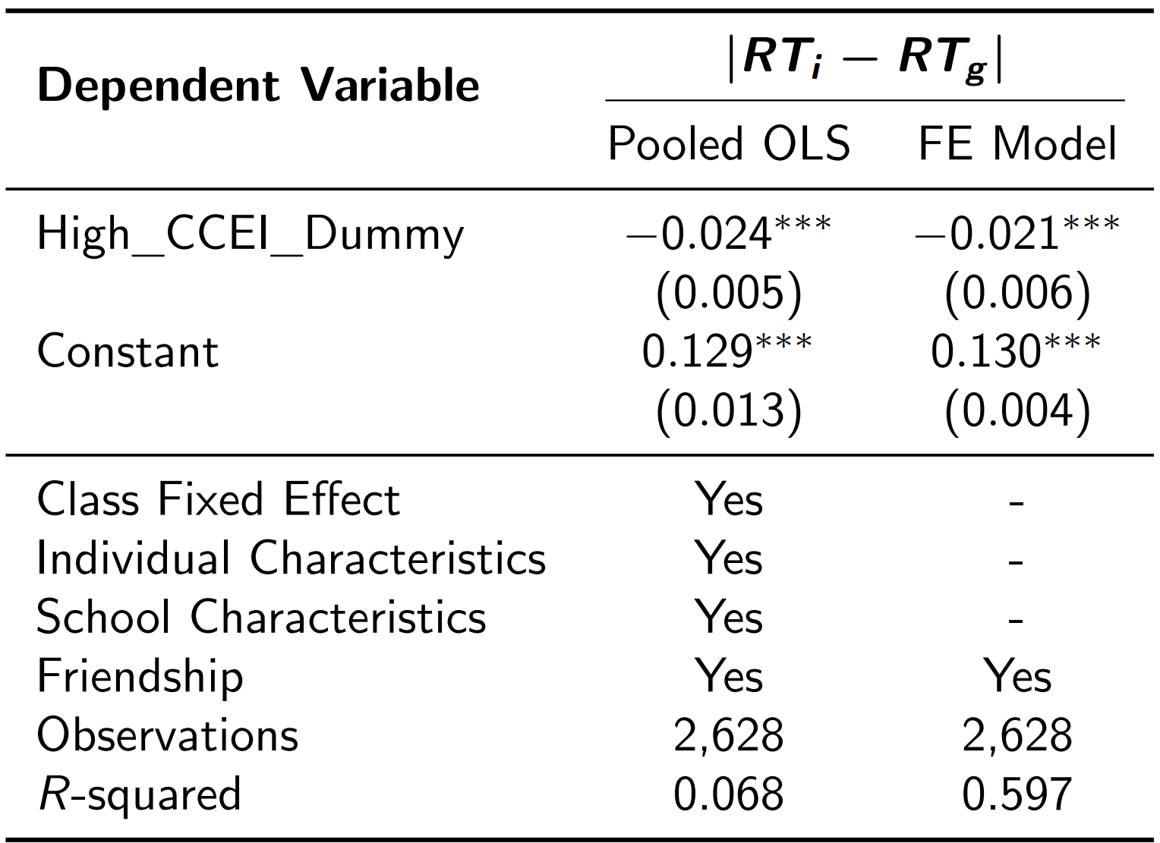
Risk Aversion
Collective risk preference is closer to the individual risk preference of a more rational individual.

Slide 7
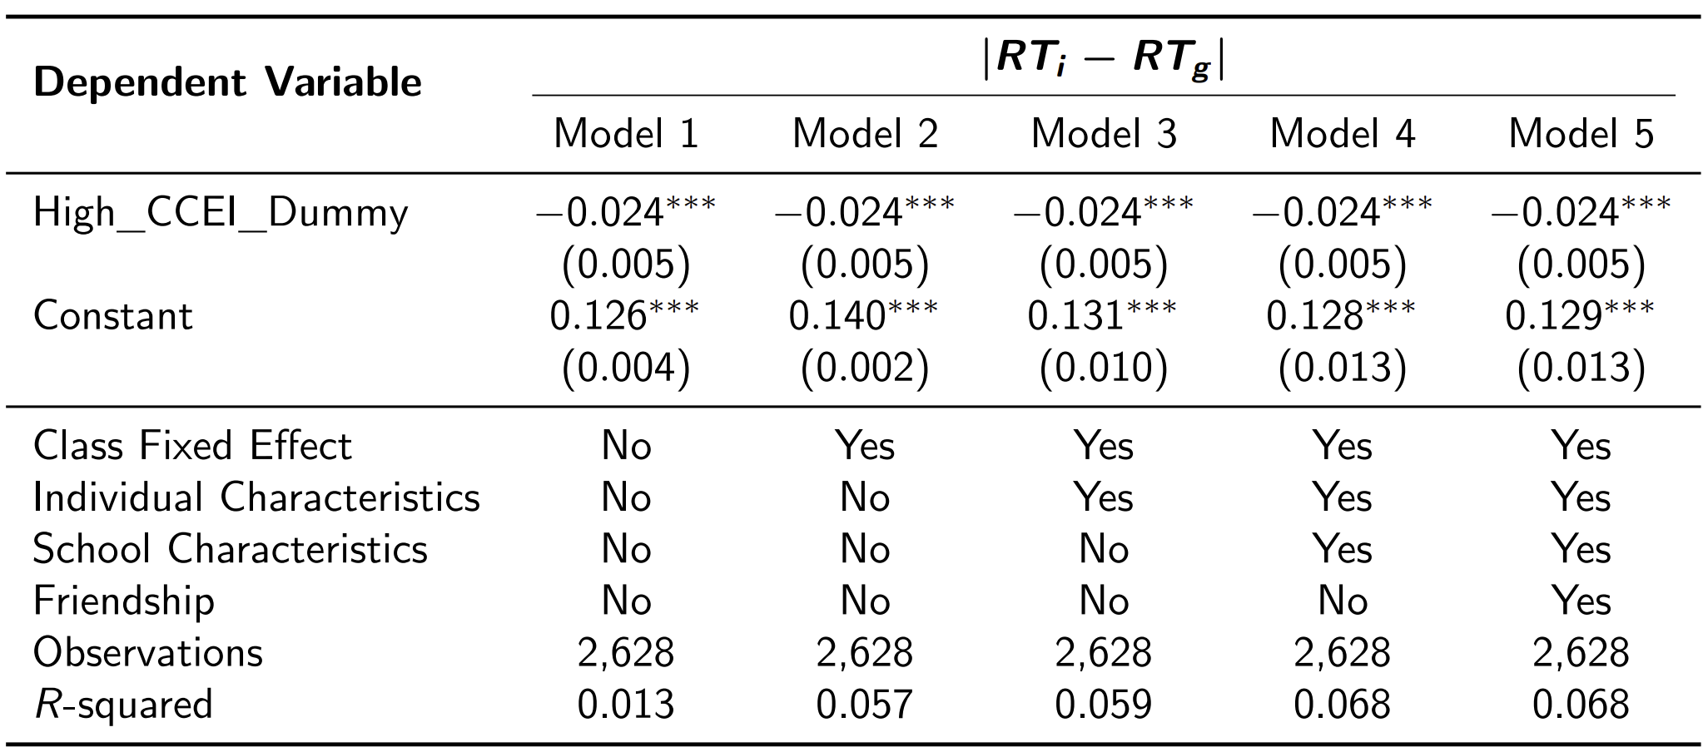
(수정) Rationality Extension

Slide 8
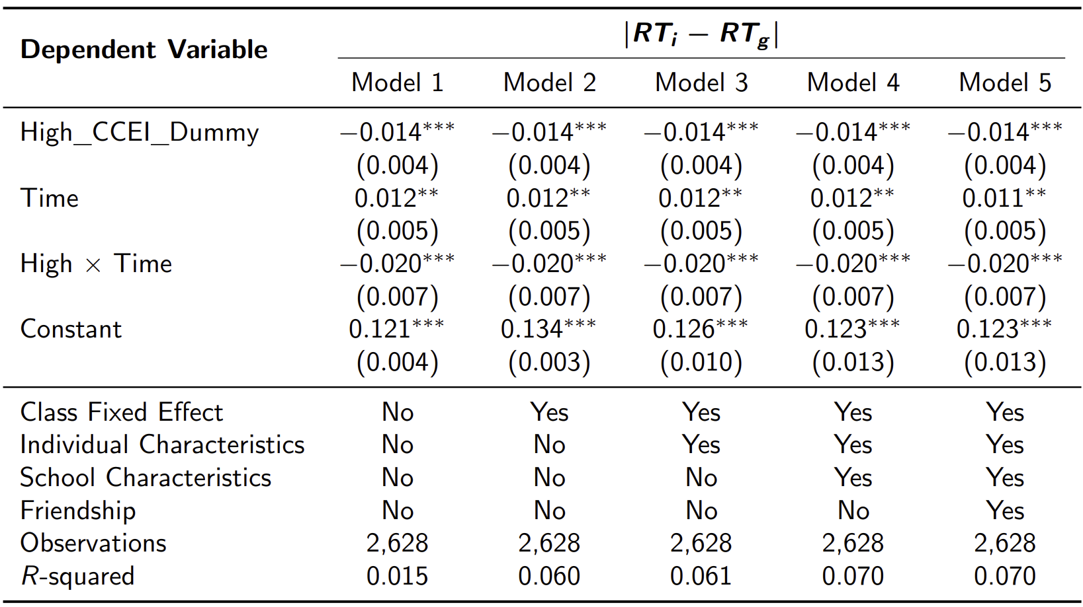
(수정) Risk Aversion

Slide 9
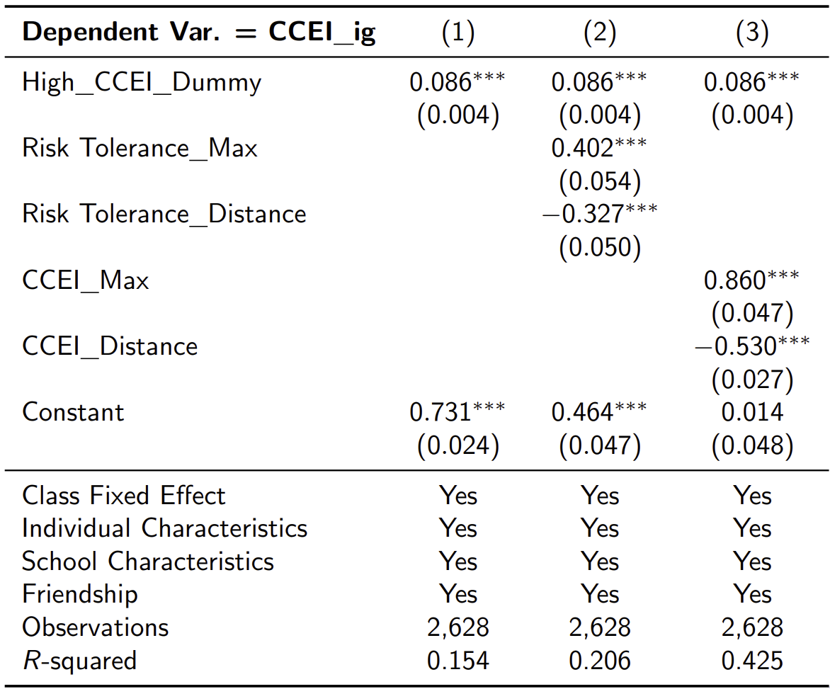
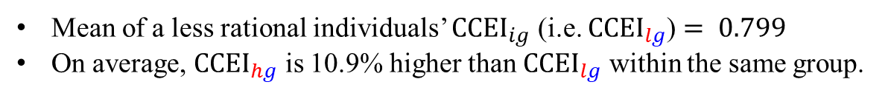
Revealed Influence of More Rational Individuals
Mean of a less rational individuals’ ${CCEI}_{ig}$ (i.e. ${CCEI}_{lg}$) $= 0.799$
On average, ${CCEI}_{hg}$ is 10.9% higher than ${CCEI}_{lg}$ within the same group.

Slide 10
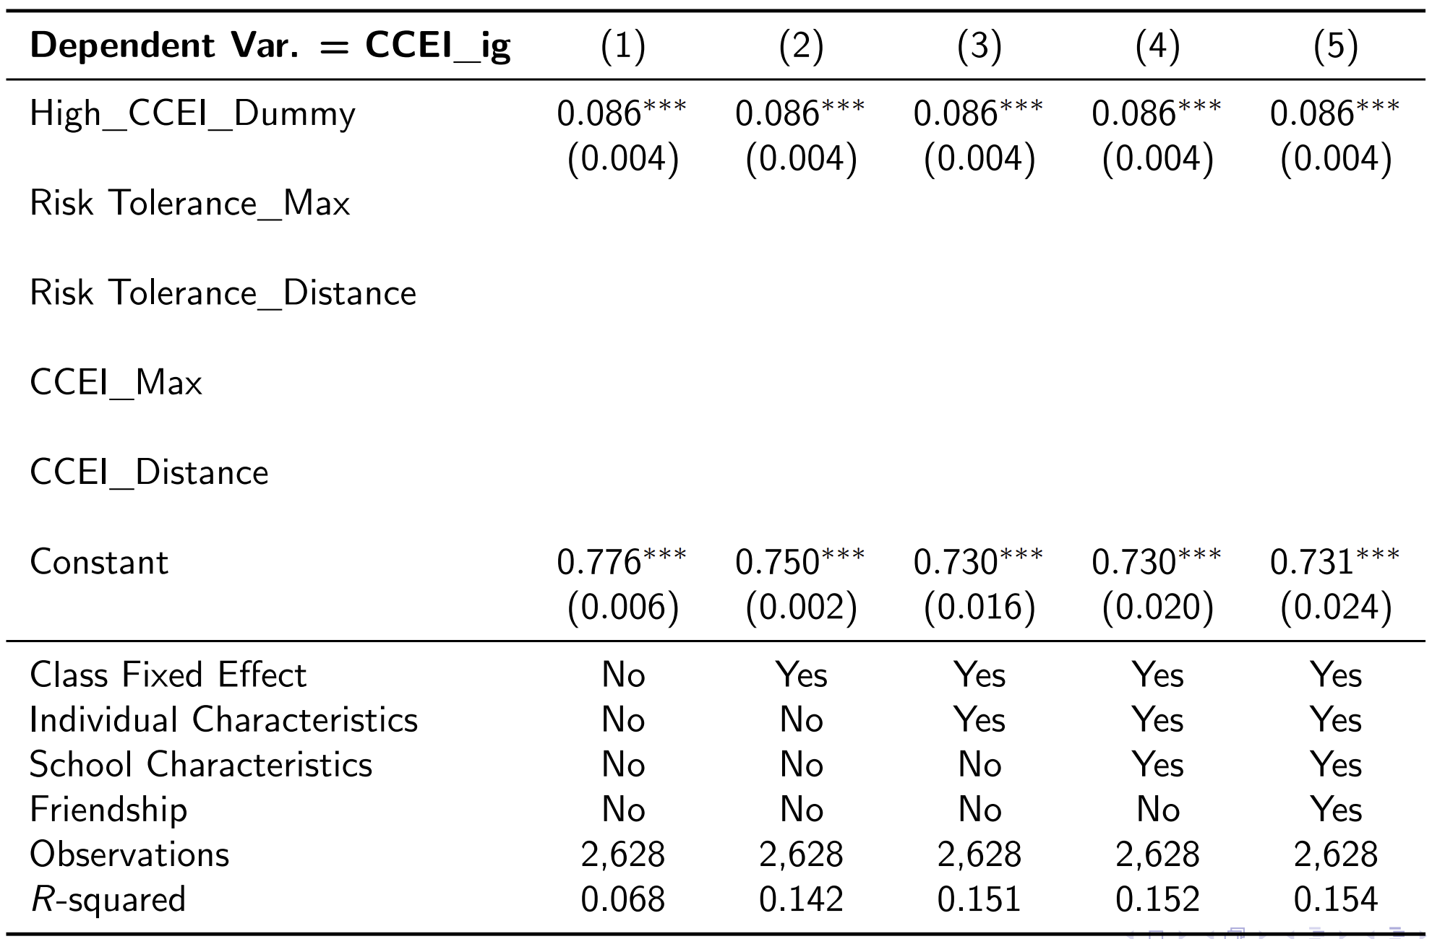
(수정)Revealed Influence of More Rational Individuals

Slide 11
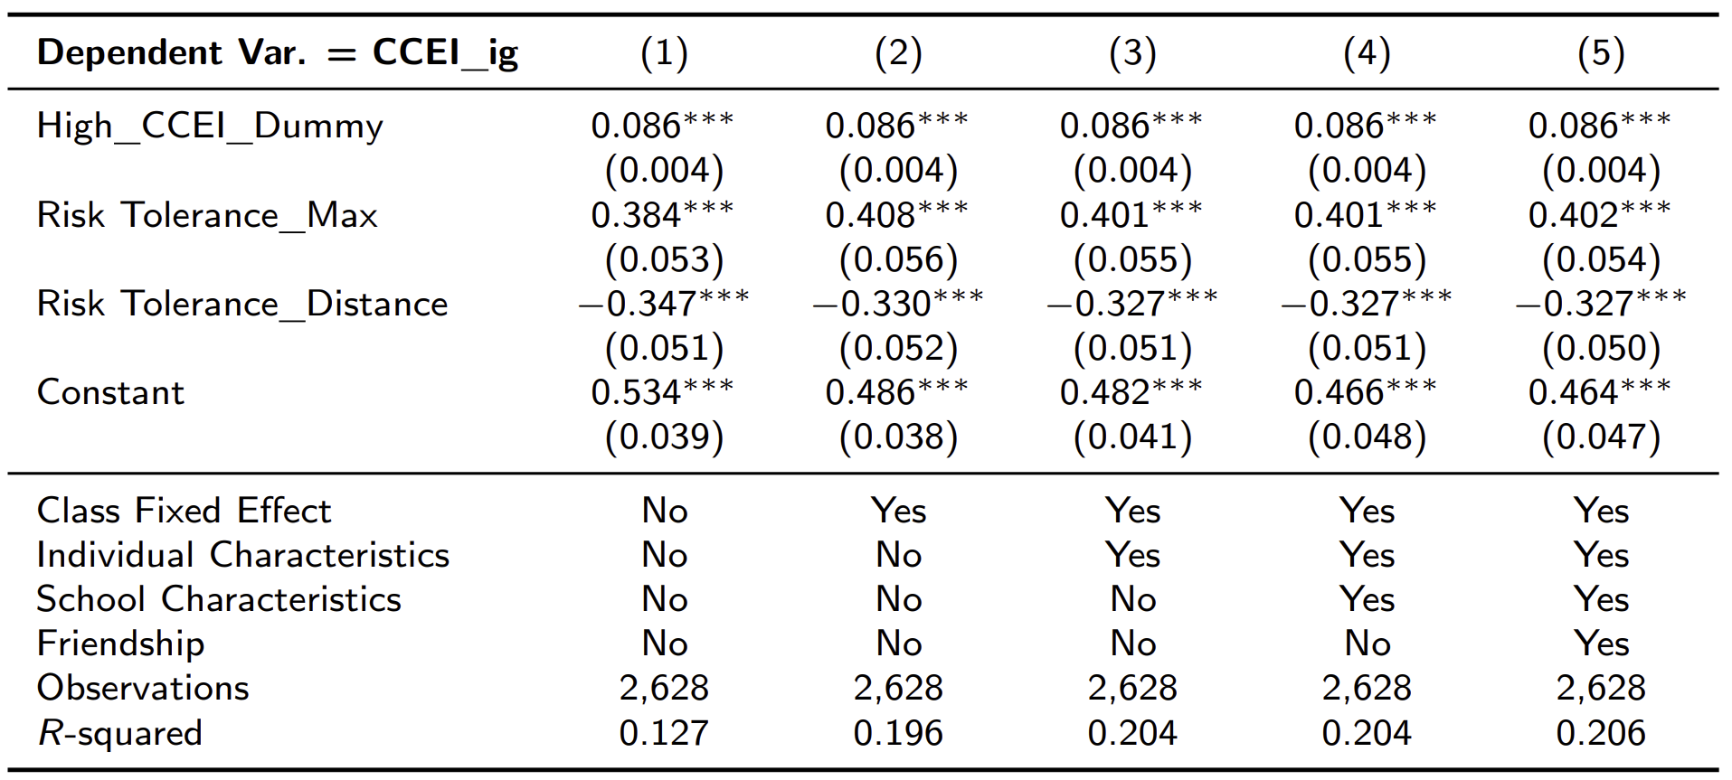
(수정)Revealed Influence of More Rational Individuals

Slide 12
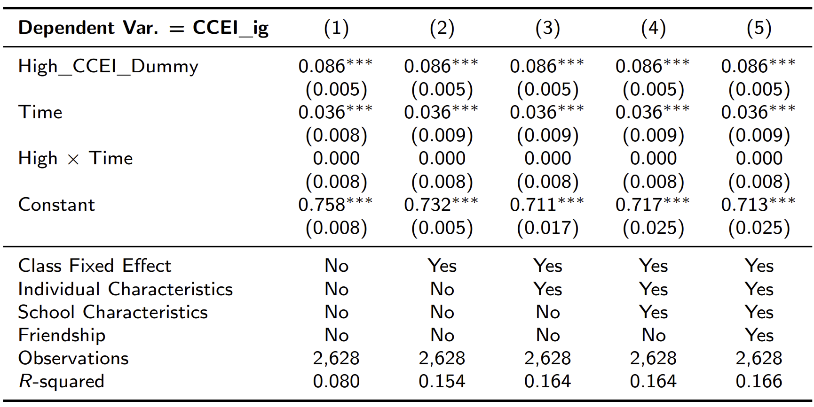
(수정)Revealed Influence of More Rational Individuals

Slide 13
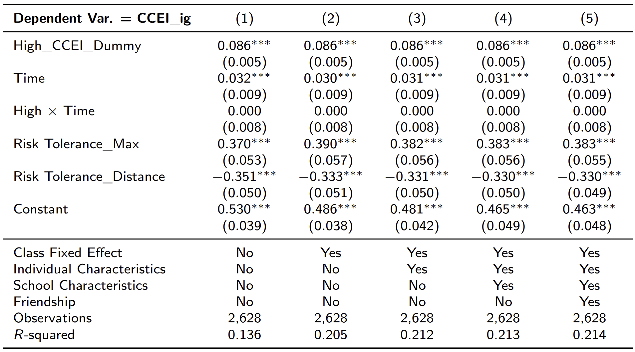
(수정)Revealed Influence of More Rational Individuals

Slide 14
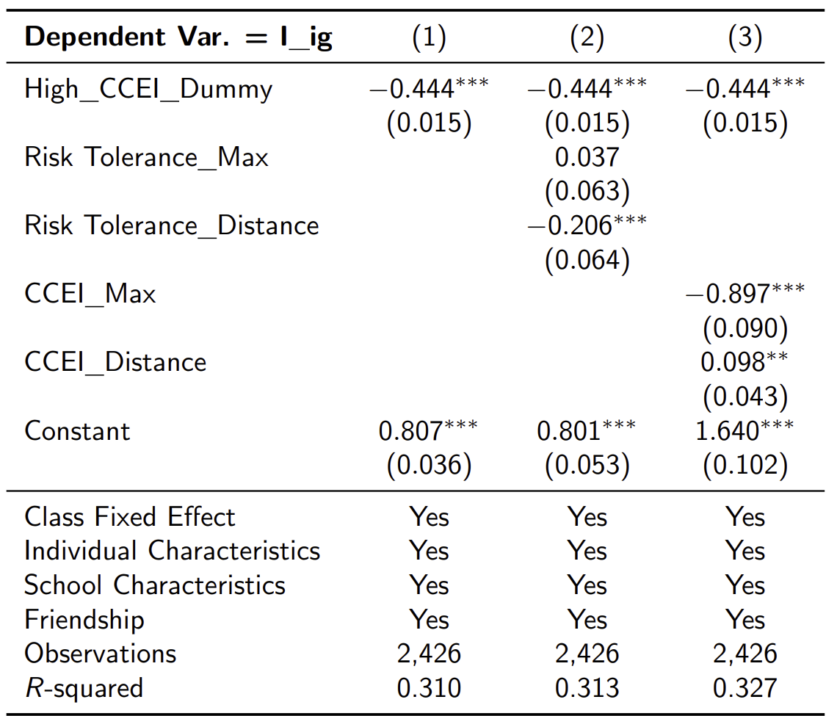
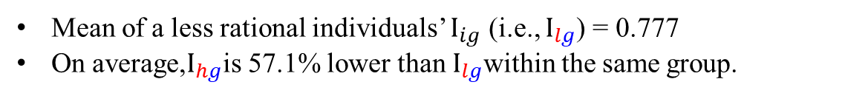
Revealed Influence of More Rational Individuals
Mean of a less rational individuals’ $I_{ig}$ (i.e., $I_{lg}$) = 0.777
On average,$I_{hg}$is 57.1% lower than $I_{lg}$within the same group.

Slide 15
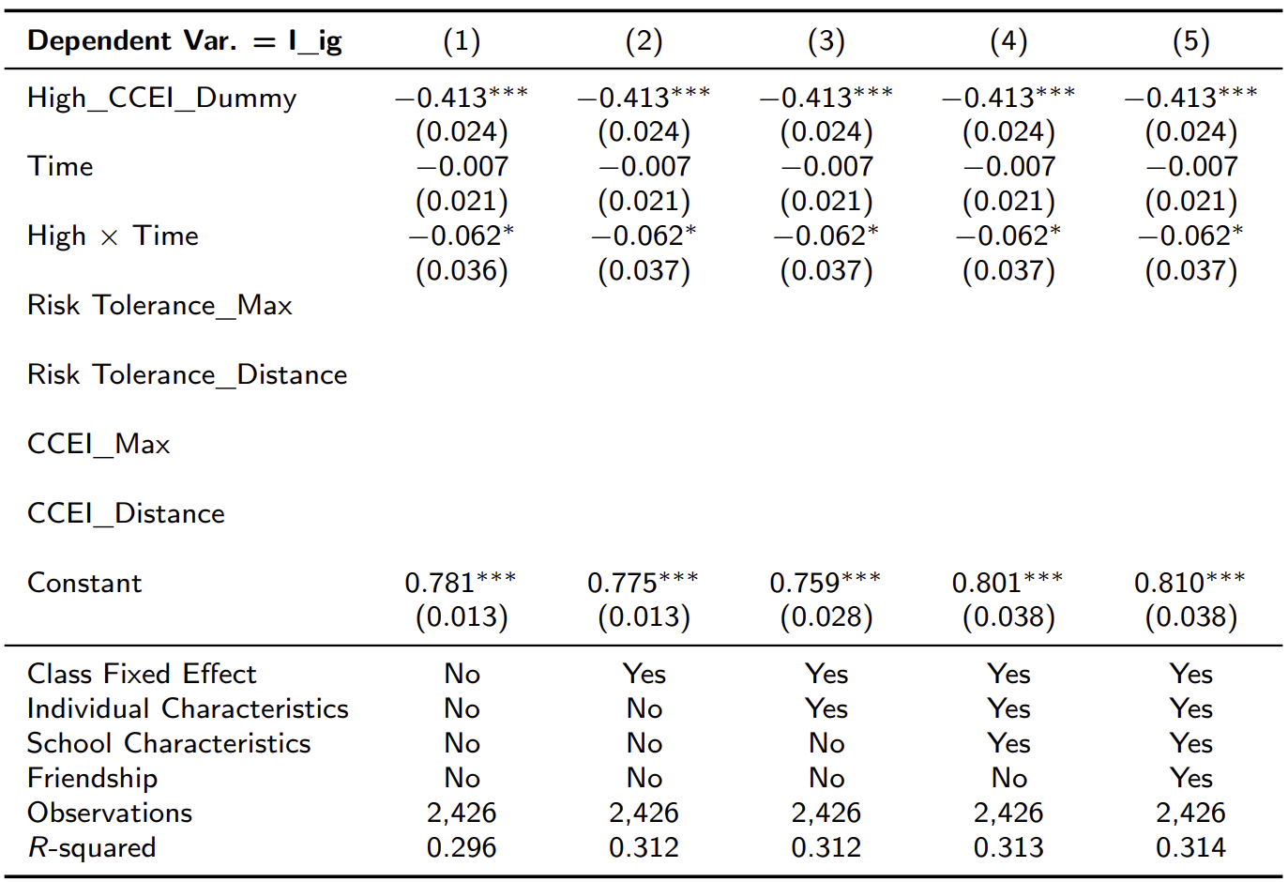
(수정) Revealed Influence of More Rational Individuals

Slide 16
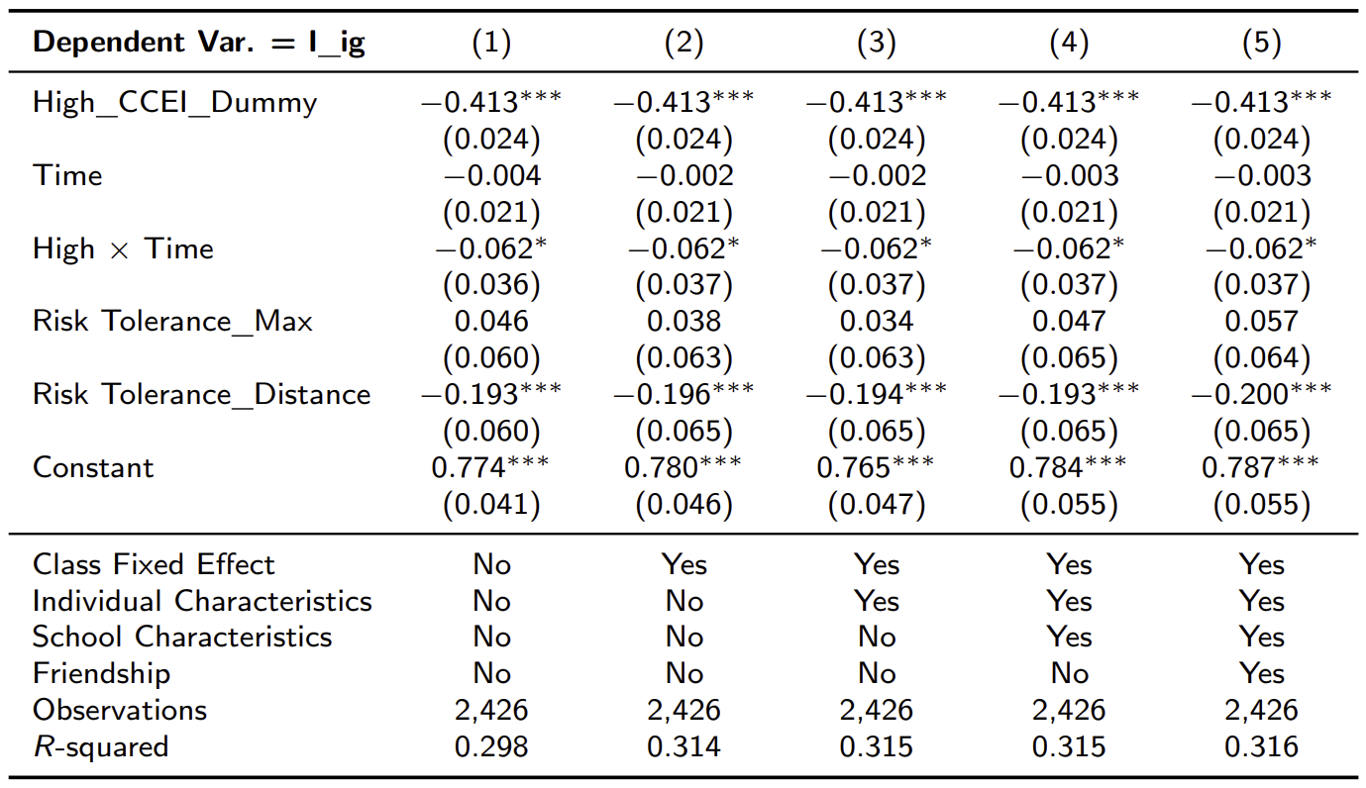
(수정) Revealed Influence of More Rational Individuals

Slide 17
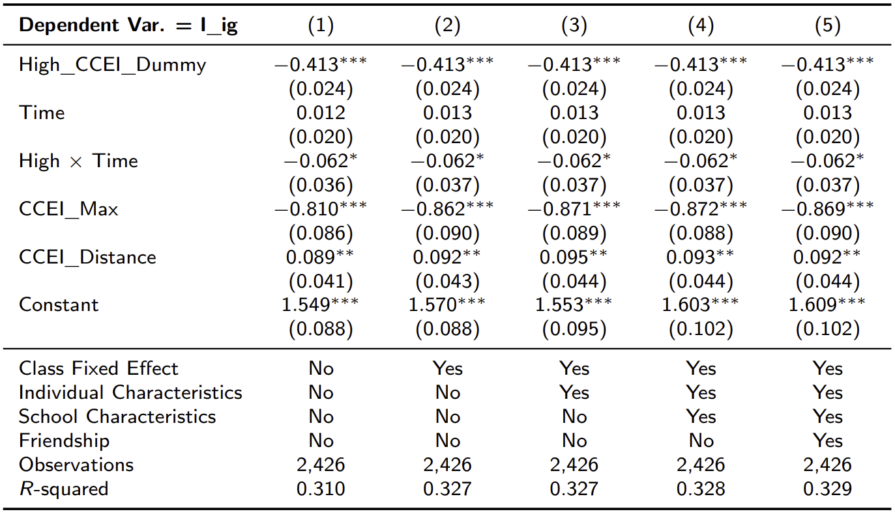
(수정) Revealed Influence of More Rational Individuals

Slide 18
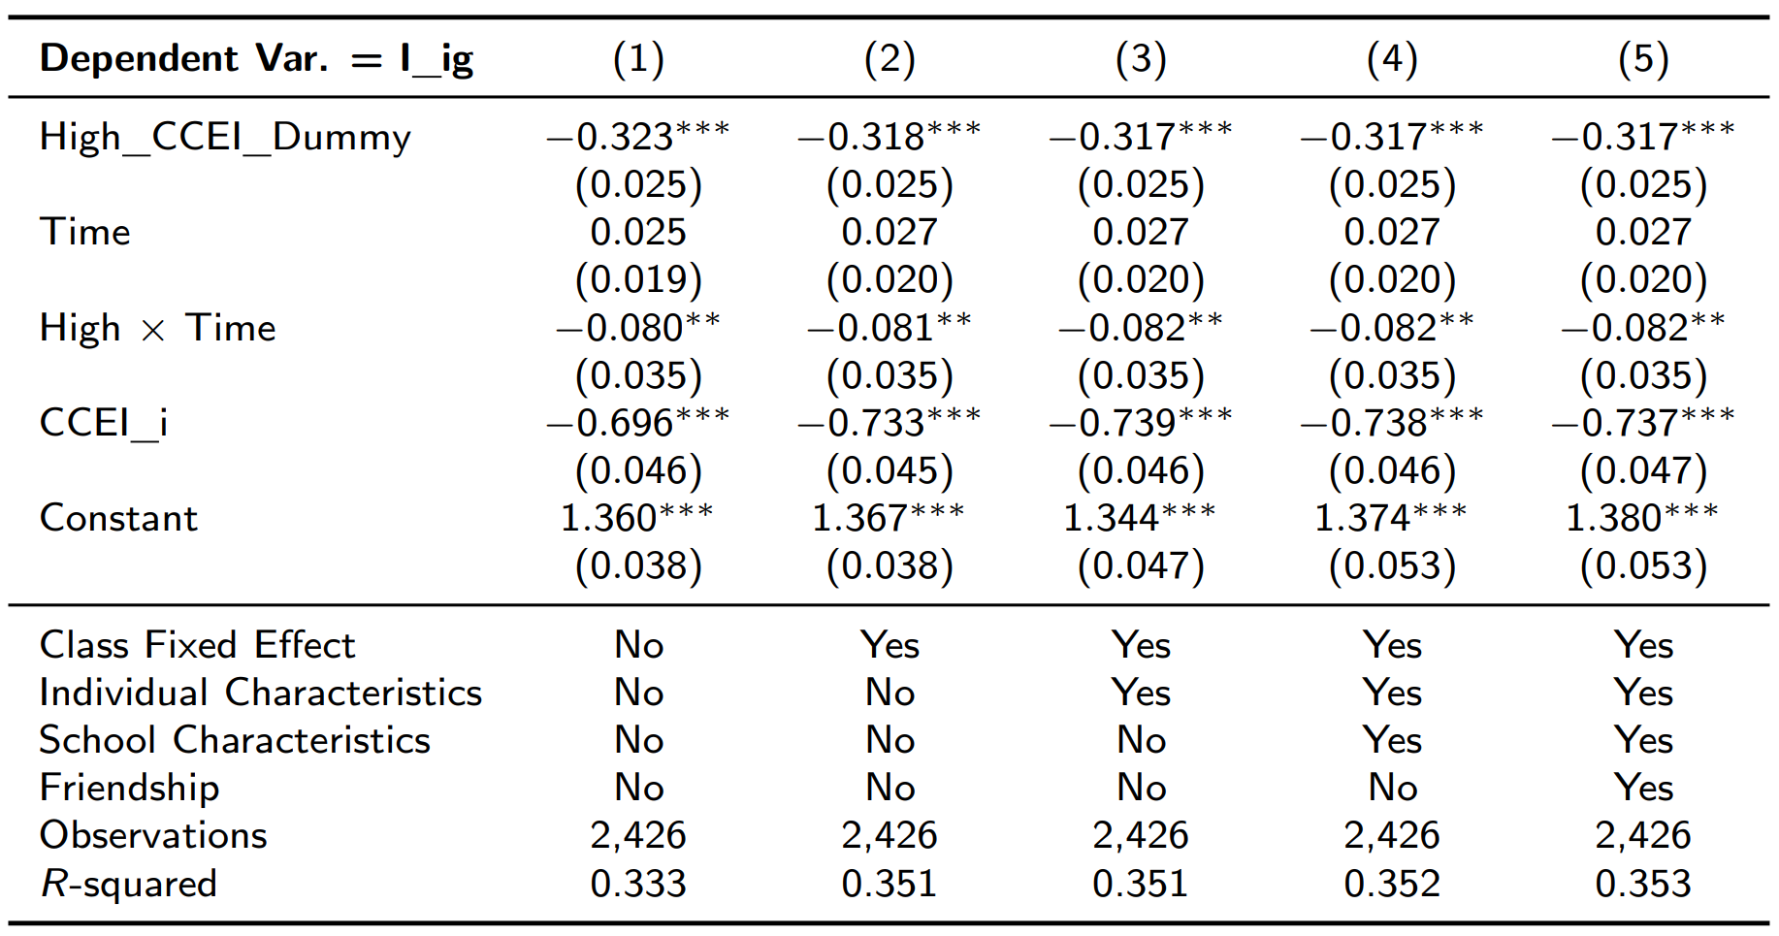
(수정) Revealed Influence of More Rational Individuals

Slide 19
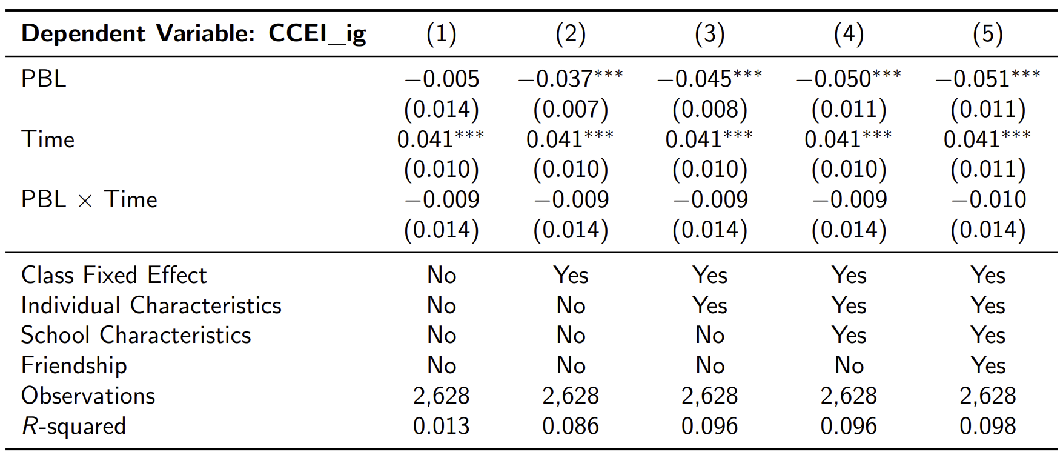
PBL effect: CCEI_ig

Slide 20
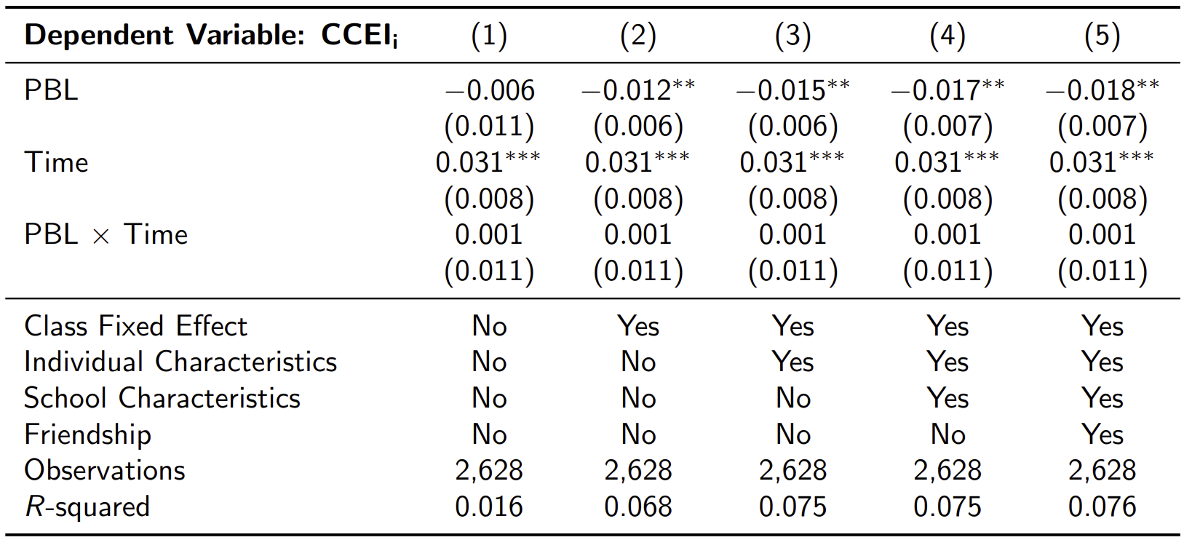
PBL effect: CCEI_i

Slide 21
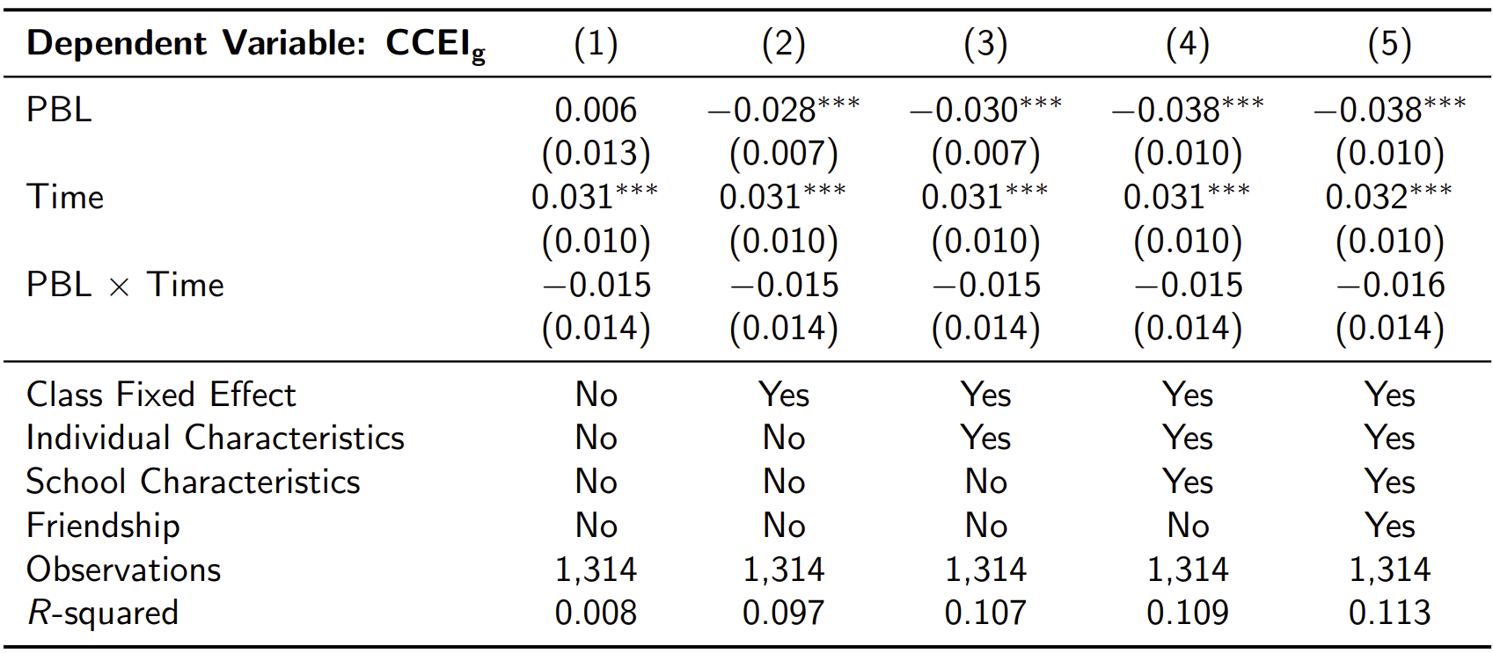
PBL effect: CCEI_g

Slide 22
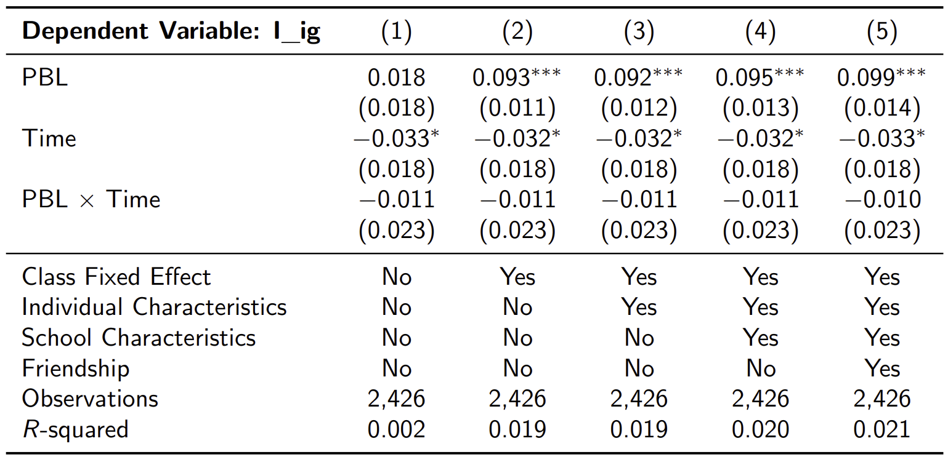
PBL effect: I_ig

Slide 23
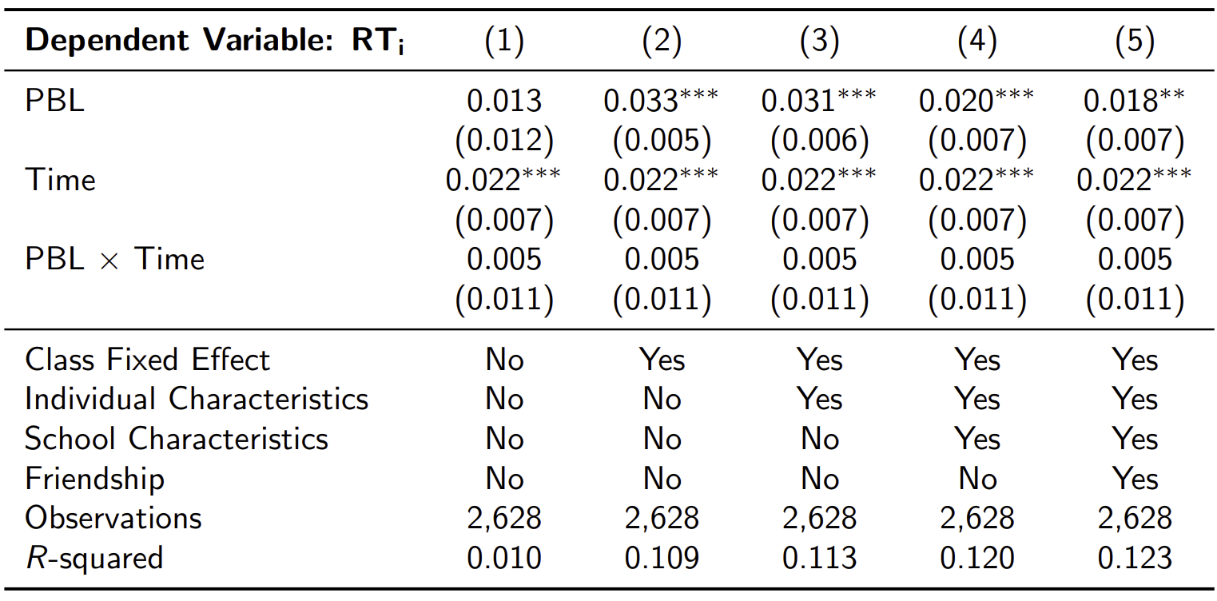
PBL effect: RT_i

Slide 24
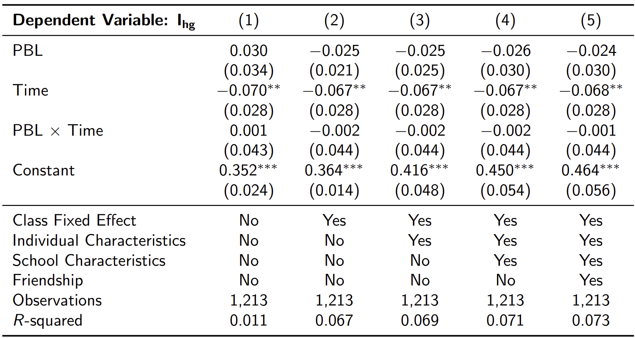
PBL effect: I_hg

Slide 25
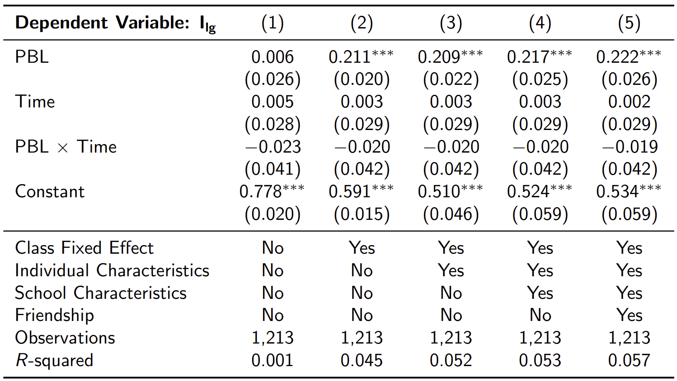
PBL effect: I_lg

